Slide 1
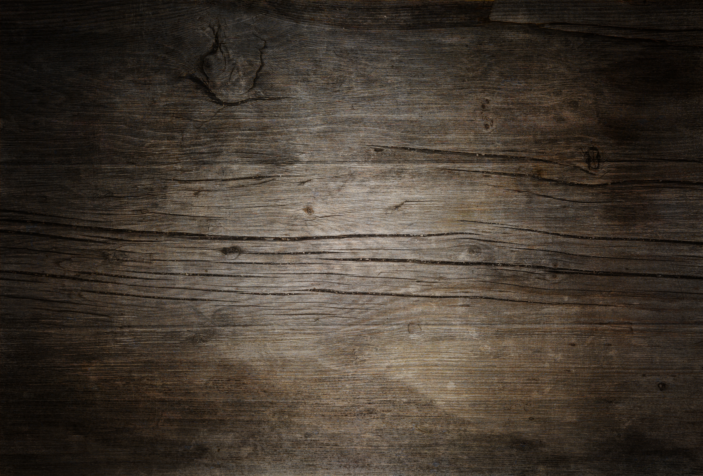
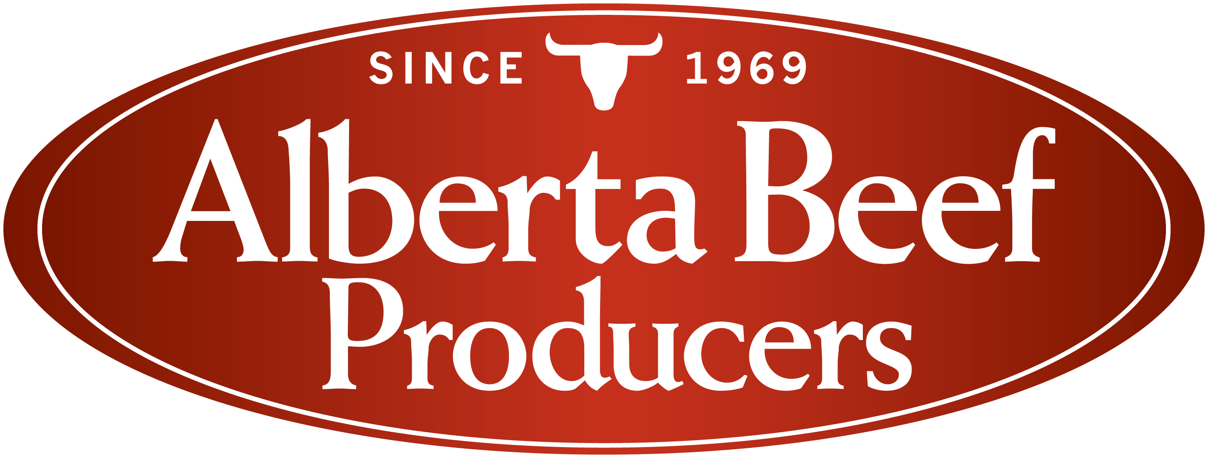

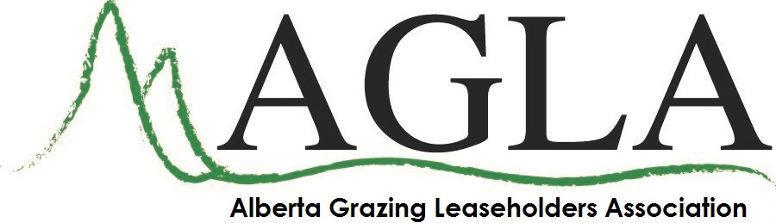

TITLE OF PRESENTATION
Presenter
Date

Slide 2
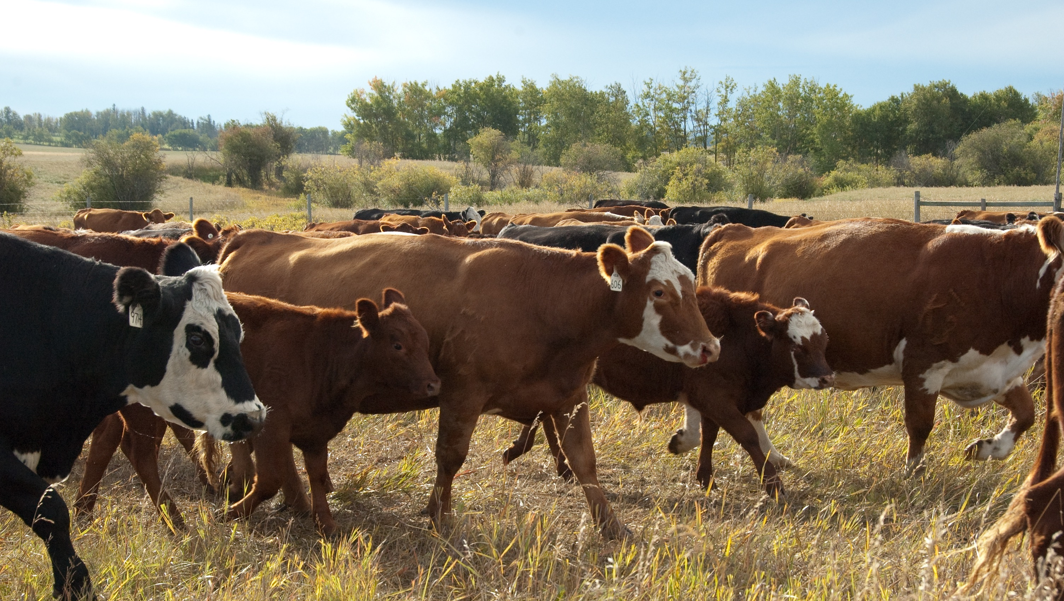
Alberta’s Beef Industry
June 30, 2021

Slide 3
Organizations
Represented by General Manager, Brad Dubeau
Legislated commission for Alberta’s entire beef industry
Work on behalf of all sectors of the beef industry and all of Alberta’s 18,000 producers
Funded by a check-off fee ($2.00) that is paid every time an animal is sold

Slide 4
Organizations
Represented by Manager of Environment and Sustainability, Larry Thomas
National voice for Canada’s 60,000 beef producers, the bulk of whom are in Alberta and Saskatchewan

Slide 5
Organizations
Represented by General Manager, Lindsye Dunbar
Membership organization that has actively represented the interests of all grazing leaseholders since 1998
There are roughly 5,700 grazing leases in Alberta, covering an estimated 5.2 million acres (2.1 million hectares)

Slide 6
Organizations
Represented by General Manager, Lindsye Dunbar
Established in 1896, WSGA is the longest running agriculture organization in Alberta
Province-wide, voluntary membership represents over half a million head of cattle and three million hectares of rangeland
WSGA has a long history of involvement in policy as it pertains to land use and beef industry issues

Slide 7
Beef Production in Canada
Of the 3.5 million beef cows in Canada, about 72% are on farms and ranches in Alberta and Saskatchewan
The beef industry is Canada’s 2nd largest agricultural sector, contributing $21.8 billion to the national GDP and supporting 350,000 full-time equivalent jobs
These family-run operations rely on access to land and water to support their livestock, forage and feed production, and irrigation
Notes:
Larry

Slide 8
Beef Production in Canada
To protect these resources for future generations, the Canadian beef industry has set a host of ambitious 2030 goals including promoting and supporting:
  Groundwater recharge
  Water quality
  Soil water retention
  Future water supplies
Other commitments include managing for healthier landscapes, protecting species at risk, and resilience to drought and flooding.
Since 1970, 75% of native grasslands in North America have been lost to conversion and development
With those grassland losses, habitat fragmentation has led to over 60 species currently at risk
Notes:
Larry

Slide 9
History of Beef Production In Alberta

Slide 10
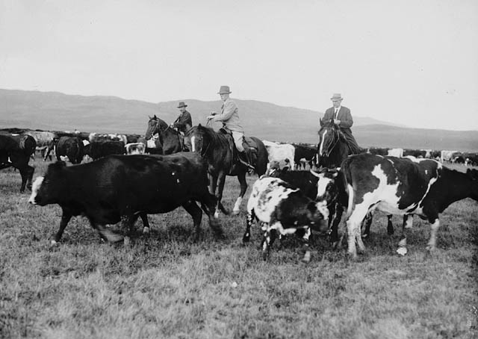
History of Beef Production in Alberta
1873 – First 12 head of breeding cattle brought to Alberta
1879 – George Emerson and Tom Lynch started the first ranching operation around the Highwood River
1881 – the Canadian Government leased out ranches for up to 100,000 acres, but they had to have at least 1 cow for every 10 acres.
1882 – Alberta’s herd grew to over 9,000 head of cattle
Bar U Ranch 1919 – Library and Archives Canada

Slide 11
History of Beef Production in Alberta
Simultaneously, the government set cattle stocking rates were found to be much too high
The harsh winter of 1886-87 killed a large portion of the Alberta cattle herd that was already weakened from low forage supplies
In 1870, the Canadian Government enacted the Homestead Act, encouraging settlers to take over the agricultural areas of the province

Slide 12
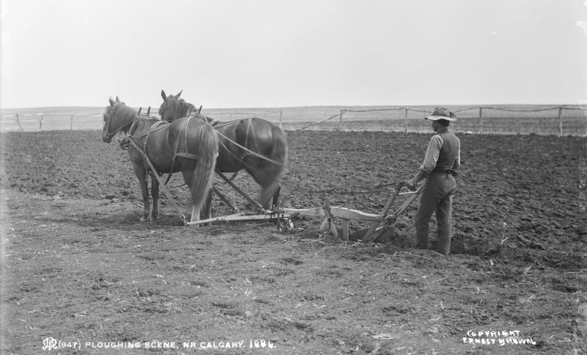
History of Beef Production in Alberta
For homesteaders to take ownership, they needed to grow cereal crops for 4 consecutive years
Climactic conditions in southern Alberta were unexpectedly variable, causing over 40% of homesteaders from 1905 – 1930 abandoning the agreement
The high risk of bankruptcy led the government to recognize the financial liability of cropping in parts of Alberta
Farming near Calgary 1884 - Alberta’s Historic Places

Slide 13
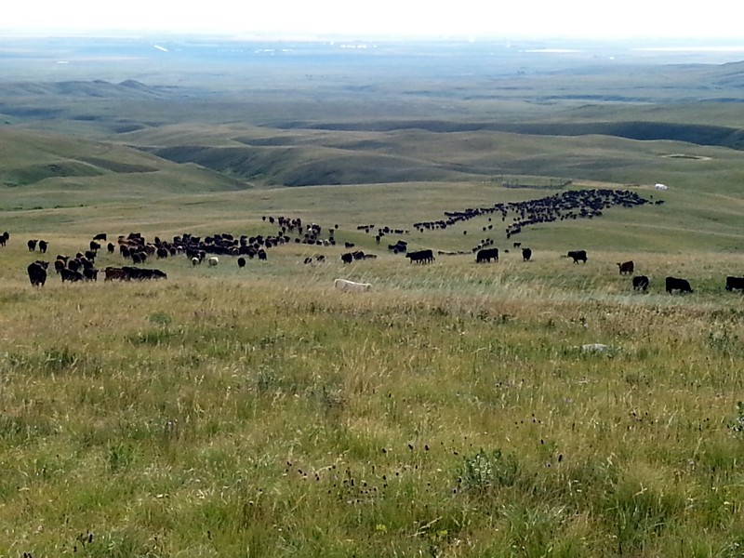
The Beginning of Rangeland Stewardship
The government reclaimed massive tracts of land and re-issued them as grazing leases
This limited producer ability to intensively crop or overgraze cattle, in order to stabilize profitability and tax revenue
The science of range management started to develop at this time
Attempts were made to bring in new, “more productive” species of forage, but they failed to thrive in certain areas
Ranchers recognized native grass communities were high-quality, climate-resistant forages if managed properly

Slide 14
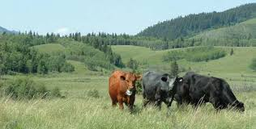
The Beginning of Rangeland Stewardship
As time passed, ranchers started to work more in tune with the native ecosystem
Ranchers became skilled at knowing their land and how to properly time grazing to minimize impacts
This made ranching a uniquely compatible use for these grasslands
The Alberta ranching model provides a similar role to that of the bison that previously roamed the plains

Slide 15
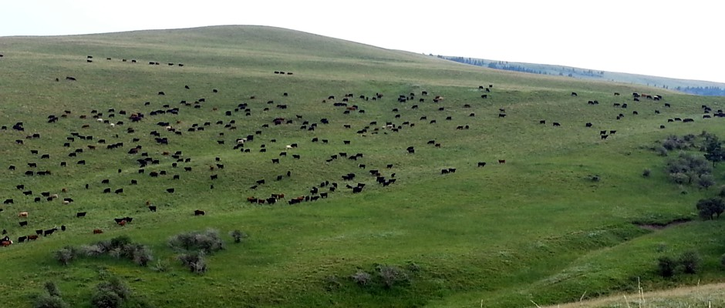
Early Industry Expansion
The early 1900s advancements in range management contributed to a stable forage supply for beef producers
The relative success of the Homestead Act in other areas of the province caused the crop sector to grow
Excess from the crop industry could be used for beef production, fueling a fed cattle industry

Slide 16
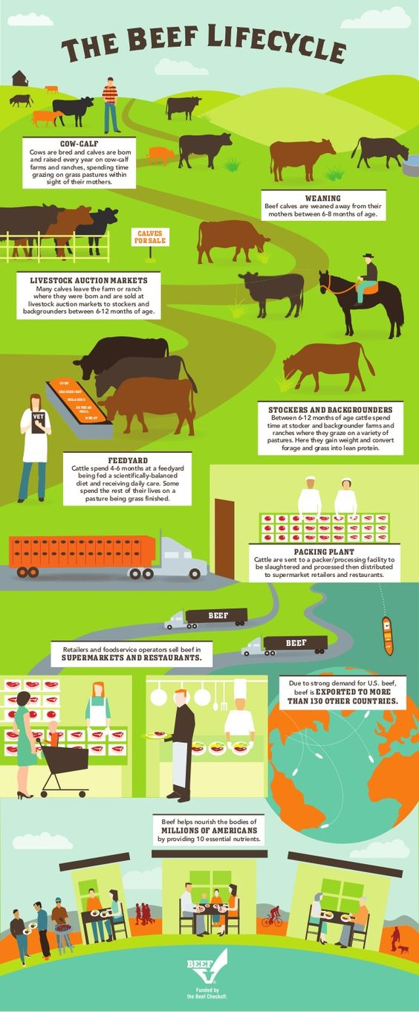
Funded by US Beef Checkoff

Slide 17
Industry Structure
Seedstock – provides the next generation of high-quality genetics for breeding stock that supplies the cow-calf and other seedstock producers
Cow-calf – calves are generally born in the spring, graze with their mothers all summer and are weaned in the fall or early winter at 6-8 months of age. When sold, they may enter a backgrounding or feedlot operation
Backgrounding operations buy weaned calves and put them on a high forage diet to grow their frame (body) size
Feedlots provide a high-quality, high-energy diet (for between 60 and 200 days) to efficiently deposit lean muscle and fat until the animal has reached the desired liveweight and estimated carcass composition

Slide 18
Rangeland Stewardship in Alberta
Rangeland stewardship is more than just grazing resources. Today, producers aim to steward water and wildlife resources as well.
Beef producers rely on mountain streams, ground water, creeks, and rivers to supply cattle drinking water
  Cattle grazing in large areas need multiple water sources to best utilize all the landscape. If water is limited, cattle will concentrate around a water source causing ecological damage
  To protect sensitive areas around water sources, they are often fenced off and “off-site” water provided via pumps, pipelines, or troughs

Slide 19
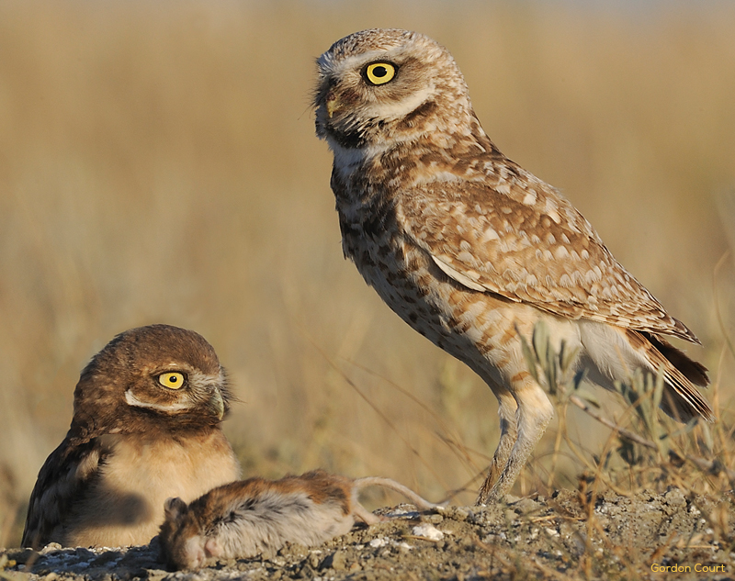
Ecological Goods and Services
Cattle production provides many ecological goods & services (EG&S) including:
  Water purification
  Minimizing erosion
  Carbon sequestration and storage
  Wildlife habitat and biodiversity
  Utilization of land that is not suitable for crop production

Slide 20
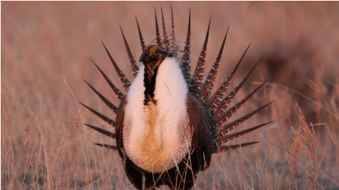
Ecological Goods and Services
If native rangeland is converted to other land uses, up to 50% of the carbon stored in the soil can be released
  About 1.5 billion tonnes of carbon is stored in Canada’s pastureland
Cattle grazing provides habitat for game species such as deer, moose, and antelope, and endangered species, such as sage grouse, burrowing owl, and loggerheaded shrike.
Some of these species are reliant on ranching for their habitat needs, and without cattle could become extinct

Slide 21
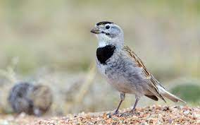
Ecological Goods & Services
For example, a McCown’s Longspur needs heavily grazed habitat to survive
Greater Sage Grouse need a varied landscape to successfully feed and rear their young
Beef producers are the managers of the landscape that provide these habitats
Many of these species don’t occur in protected parks because those areas do not have grazing pressure that creates and maintains their desired habitats
.

Slide 22
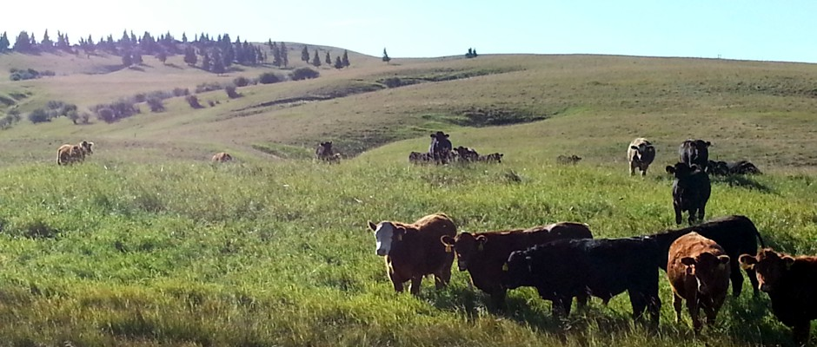
Grazing Leases
Crown land that is leased to an individual rancher to graze and steward
The province prescribes an ecologically sustainable stocking rate (number of animals permitted to graze a certain area for a specified period) that the producer uses to ensure their use of the lease does not impact the native ecosystem
Grazing leases can be cancelled if the leaseholder is not meeting stewardship requirements

Slide 23
Grazing Leases
Ranchers are the stewards of these lands that provide EG&S, while maintaining a profitable business
Leaseholders often make significant investments in improving the lease to allow for proper management
These include things such as cross fencing to facilitate more even grazing patterns, off-site watering systems, or controlling invasive species
A Serecon study found that leaseholders invest upwards of $70 million dollars annually to steward their crown land.

Slide 24
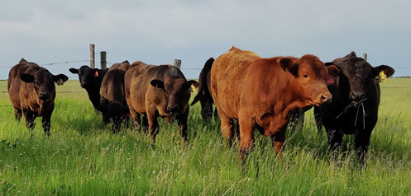
Current Industry - Alberta
About 18,000 producers
$13.6 billion in sales
$4 billion to the provincial GDP
Generates 55,125 full-time jobs; every job in the sector creates 2.7 elsewhere in the economy
Export reliant: more than 50% of production is exported
Vast majority of operations are family owned and operated
Average cowherd size: 84 mature cows

Slide 25
Industry Needs
Although the beef industry is an economic powerhouse for the province, it also faces challenges
  High input costs & regulatory burden
  Land use competition – tens of thousands of acres of pastureland are lost annually
  Water – cattle require fresh, clean water for drinking; high quality water is also critical for growing feed and forage to support cattle when they are not grazing
  Industrial activity without proper reclamation and recreational uses can damage land, introduce invasive species, and reduce forage availability
.

Slide 26
Coal Policy Considerations
We recognize the need for modernization of the 1976 Coal Policy
Potential risks to the environmental and economic sustainability of adjacent and downstream beef production need to be heard and carefully considered
These impacts need to be considered in context and consultation with other regulations and departmental jurisdictions (e.g., Alberta Environment and Parks); not in isolation under the sole purview of the Ministry of Energy

Slide 27
Coal Policy Considerations
There are several factors that should be considered when developing a new coal policy:
  Reclamation risk to native ecosystems, including ability to reclaim if a mining company goes bankrupt; introducing tame species into native ecosystems for reclamation purposes is not ideal
  Water quality including selenium and other contaminants associated with mining activity; the ability of current technology to mitigate these impacts is uncertain
  Air quality impacts
  Land use planning for specific regions (e.g., regional land use plans developed in conjunction with stakeholders)
  Land and forage resource access and availability

Slide 28
Questions?

